Slide 1
British Airways
Web Scrapping and Analysis

Slide 2
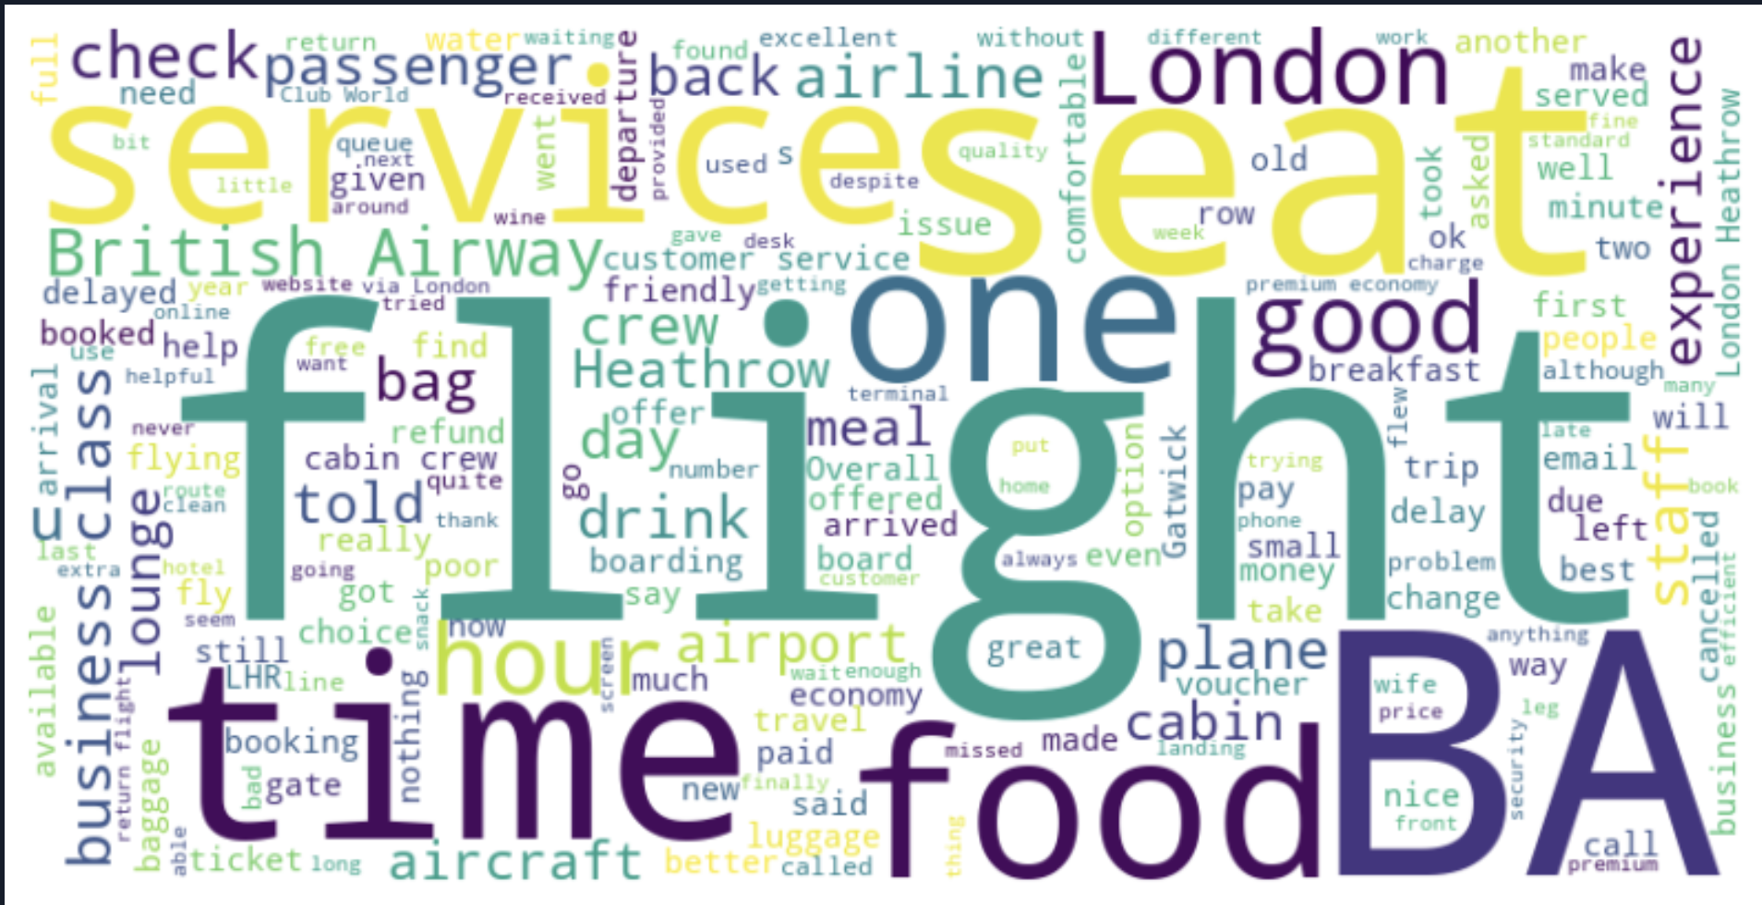
Sentiment Analysis And Most used words
The overall sentiment analysis is 0.08029459999999994 which ranges between 0 & 1. It meant it concludes positive behaviour of customers in review section.
In the word cloud people are generally talks about Flight, Service, food, time, and Experience.

